Slide 1
Propositional Logic
Course Code: CSC 1204
Course Title: Discrete Mathematics
Dept. of Computer Science
Faculty of Science and Technology
Lecturer No: | 1b | Week No: | 1 | Semester: | 23-24 Fall
Lecturer: | Dr. Ashraf Uddin & dr.ashraf@aiub.edu

Slide 2
Lecture Outline
1.1 Propositional Logic
Logic
Propositional Logic
Propositions
Propositional Variables
Compound Propositions
Logical Operators
Truth Value & Truth Table
Truth Tables of Compound Propositions
Conditional Statements
Logic and Bit Operations

Slide 3
Objectives and Outcomes
Objectives: To understand the importance of logic in mathematical reasoning, to understand proposition and propositional logic, symbol and usage of different types of logical operators.
Outcomes: Students are expected to be able to apply logical operators and analyze logical propositions via truth tables, be able to construct a truth table for a given compound proposition.

Slide 4
Key Terms
Logic: Logic is the discipline that deals with the methods of reasoning.
    Logic is the basis of all mathematical reasoning
    The rules of logic specify the meaning of mathematical statements
Propositional Logic: The area of logic that deals with propositions is called the propositional logic.

Slide 5
Key Terms
Proposition: A proposition is a declarative statement that’s either TRUE or FALSE, but not both.
Statements that are not propositions include
    questions
    Commands

Slide 6
Key Terms
Propositional variable: A variable that represents a proposition. The conventional letters used for propositional variables are p, q, r, s, t,..
Compound proposition: A proposition constructed by combining two or more propositions using logical operators (AKA : logical connectives)
Logical Operators: Operators used to combine propositions
Truth Value: The truth value of a proposition is true, denoted by T, if it is a true statement and false, denoted by F, if it is a false statement. Truth Value ==> Either True or False
Truth Table: A table displaying the truth values of propositions.

Slide 7
Proposition: Examples
Proposition | Not Proposition
3 + 2 = 32 | Bring me coffee!
3 + 2 = 5 | 3 + 2
CSC 1204 is Khalid’s favorite class | CSC 1204 is her favorite class
Every cow has four legs | Do you like Cake?

Slide 8
Logical Operators
Logical Operators ==> unary, binary
Unary:
    Negation
Binary
    Conjunction
    Disjunction
    Exclusive OR
    Conditional/Implication
    Biconditional

Slide 9
Logical Operators: Symbols & Usage
Operator | Symbol | Usage
Negation | ¬ | NOT
Conjunction | ∧ | AND
Disjunction | ∨ | OR
Exclusive or | ⊕ | XOR
Conditional | → | if, then
Biconditional | ↔ | iff

Slide 10
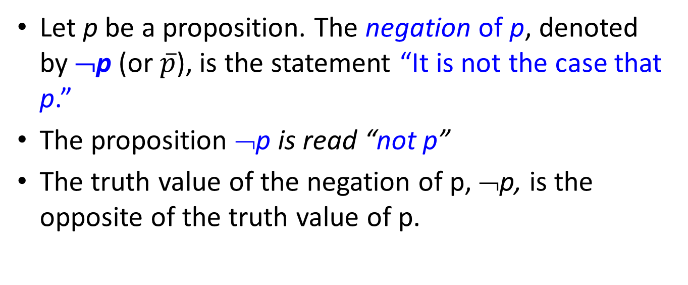
Propositional Logic : Negation
Let p be a proposition. The negation of p, denoted by ¬p (or $\overline{p}$), is the statement “It is not the case that p.”
The proposition ¬p is read “not p”
The truth value of the negation of p, ¬p, is the opposite of the truth value of p.

Slide 11
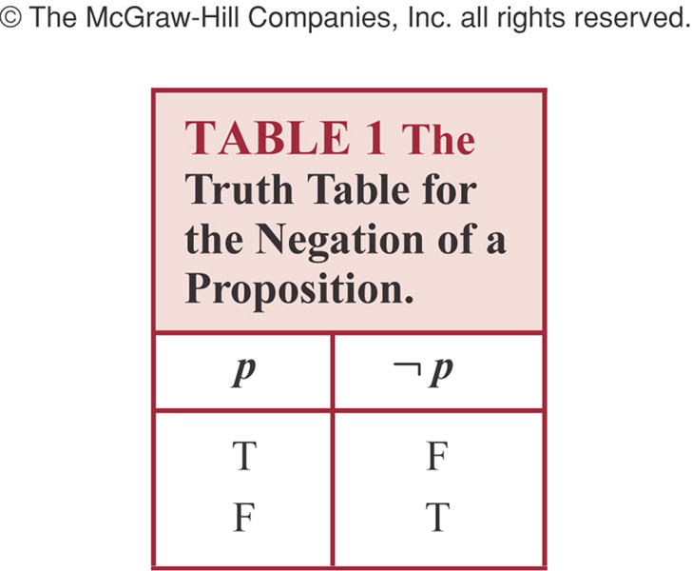
Truth table for Negation of a Proposition

Slide 12
Propositional Logic : Negation
Negation just turns a false proposition to true and the opposite for a true proposition.
Example1: P: I am going to town
    ¬ P: I am not going to town; or,
    It is not the case that I am going to town
Example2: p : “23 = 15 +7”
p happens to be false, so ¬ p is true.

Slide 13
Conjunction
Let p and q be propositions. The conjunction of p and q, denoted by p ∧ q, is the proposition “p and q.”
The conjunction p ∧ q is true when both p and q are true and is false otherwise.
Conjunction corresponds to English “AND”.
Example: Liana is curious AND clever.

Slide 14
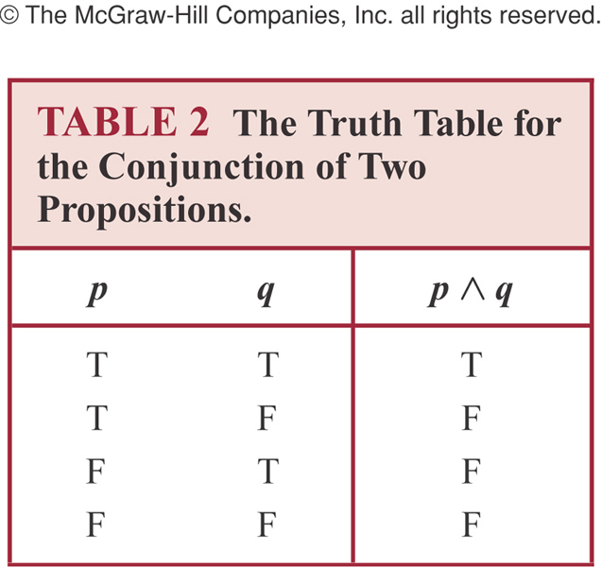
Truth Table for Conjunction

Slide 15
Conjunction: Example
Example: p : ‘I am going to town’
  q : ‘It is going to rain’
  p ∧ q: ‘I am going to town, and it is going to rain.’
  Note: Both p and q must be true to p ∧ q be true

Slide 16
Disjunction
Let p and q be propositions.
The disjunction of p and q, denoted by p ∨ q, is the proposition “p or q.”
The disjunction p ∨ q is false when both p and q are false and is true otherwise.
Disjunction is true when at least one of the components is true.
Disjunction corresponds to English “OR”.
  Example: Abdullah is brave OR intelligent.

Slide 17

Truth Table for Disjunction

Slide 18
Examples of Conjunction & Disjunction
Let,
p : 5 < 9
q : 9 < 7.
Construct the propositions p ∧ q and p ∨ q.
Solution:
  The conjunction of the propositions p and q is the proposition
  p ∧ q : 5 < 9 and 9 < 7
  The disjunction of the propositions p and q is the proposition
  p ∨ q : 5 < 9 or 9 < 7
  Question: What are the truth values of p ∧ q and p ∨ q?

Slide 19
Exclusive Or
Let p and q be propositions.
The exclusive or of p and q, denoted by p ⊕ q, is the proposition that is true when exactly one of p and q is true and is false otherwise.

Slide 20
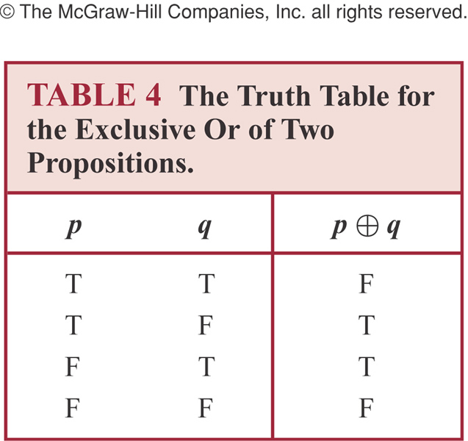
Truth Table of Exclusive Or

Slide 21
Books
Discrete Mathematics and its applications with combinatorics and graph theory (7th edition) by Kenneth H. Rosen [Indian Adaptation by KAMALA KRITHIVASAN], published by McGraw-Hill

Slide 22
References
Discrete Mathematics, Richard Johnsonbaugh, Pearson education, Inc.
Discrete Mathematical Structures, Bernard Kolman, Robert C. Busby, Sharon Ross, Prentice-Hall, Inc.
SCHAUM’S outlines Discrete Mathematics(2nd edition), by Seymour Lipschutz, Marc Lipson

